Slide 1
Primary Key

Slide 2
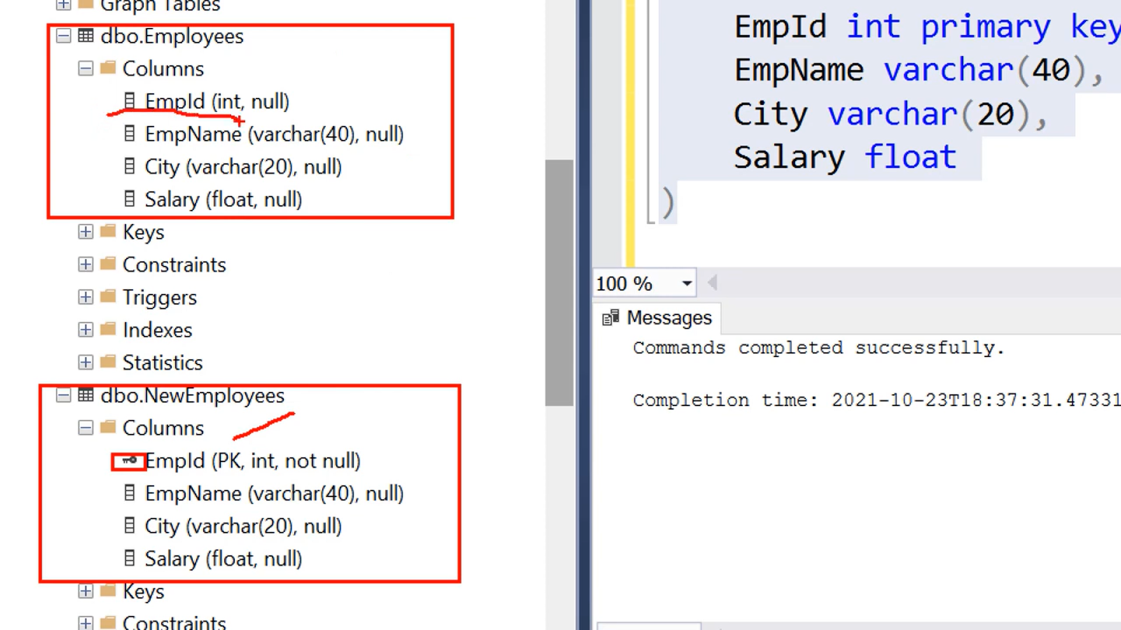
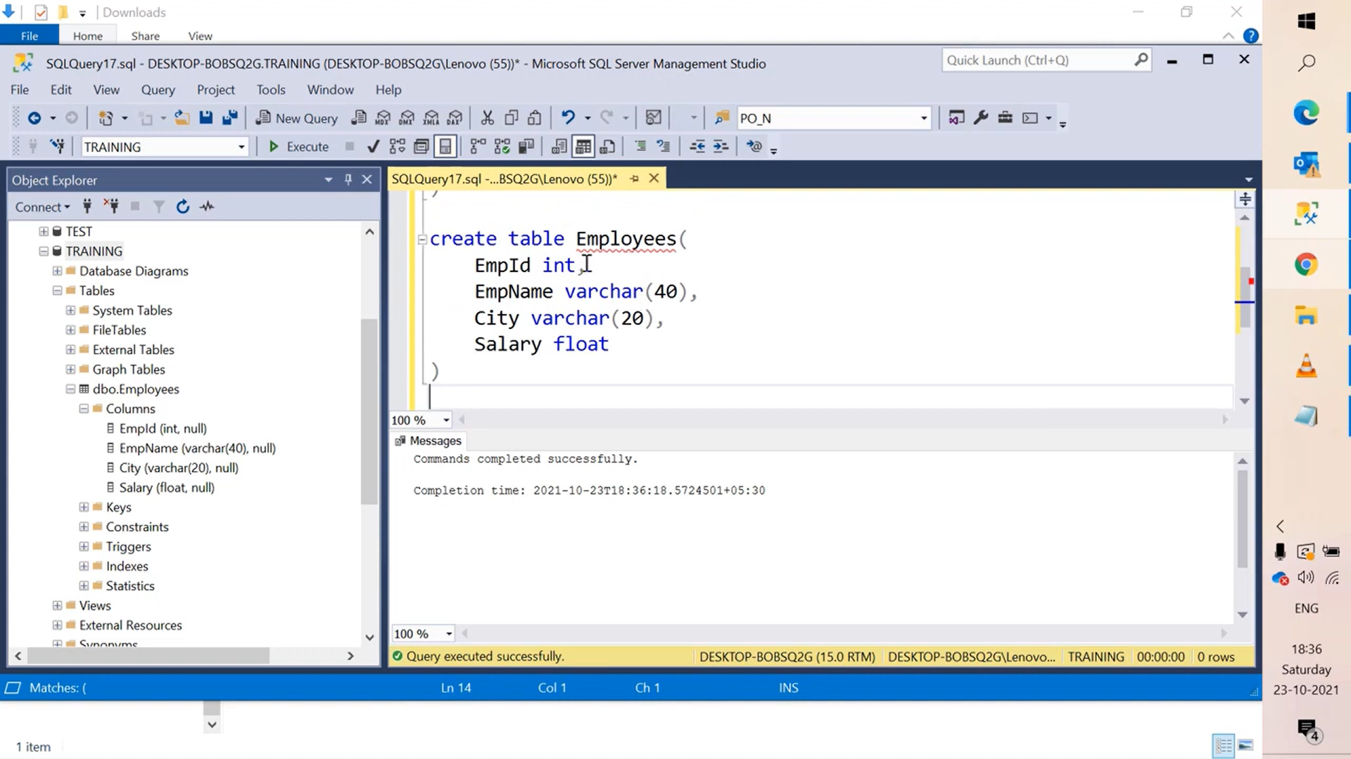


Slide 3
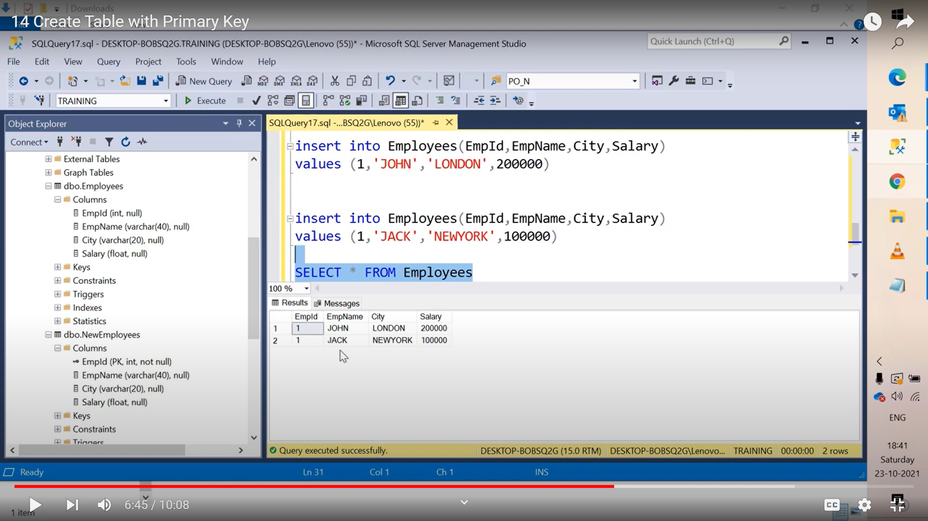

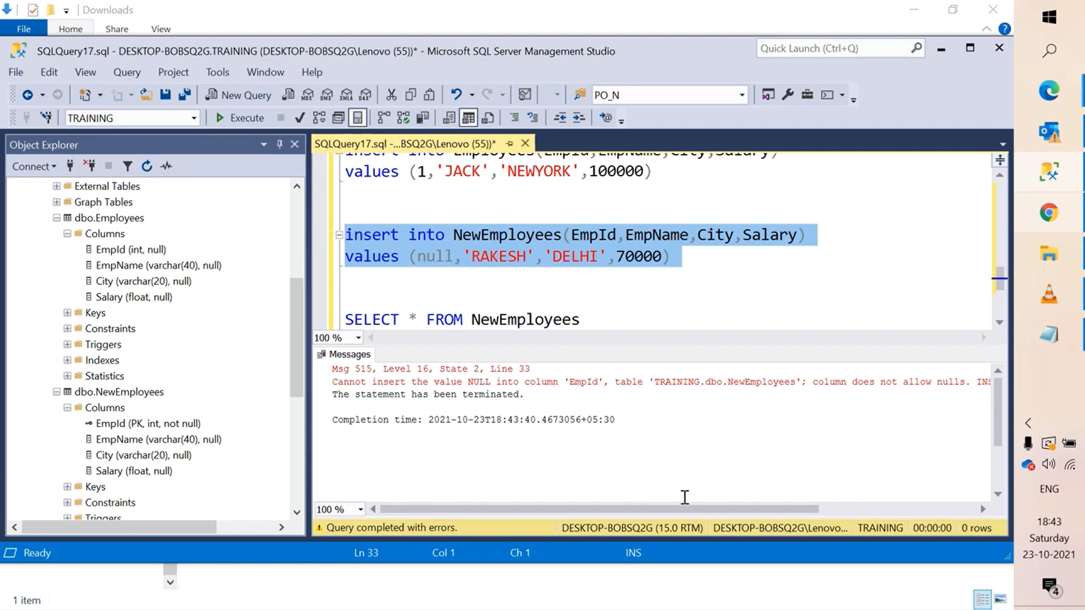
Without Primary Key
With Primary Key
1) Don’t allow duplicate data
2) Don’t allow NULL values
Primary Key can apply to only one column

Slide 4
Unique Constraint

Slide 5
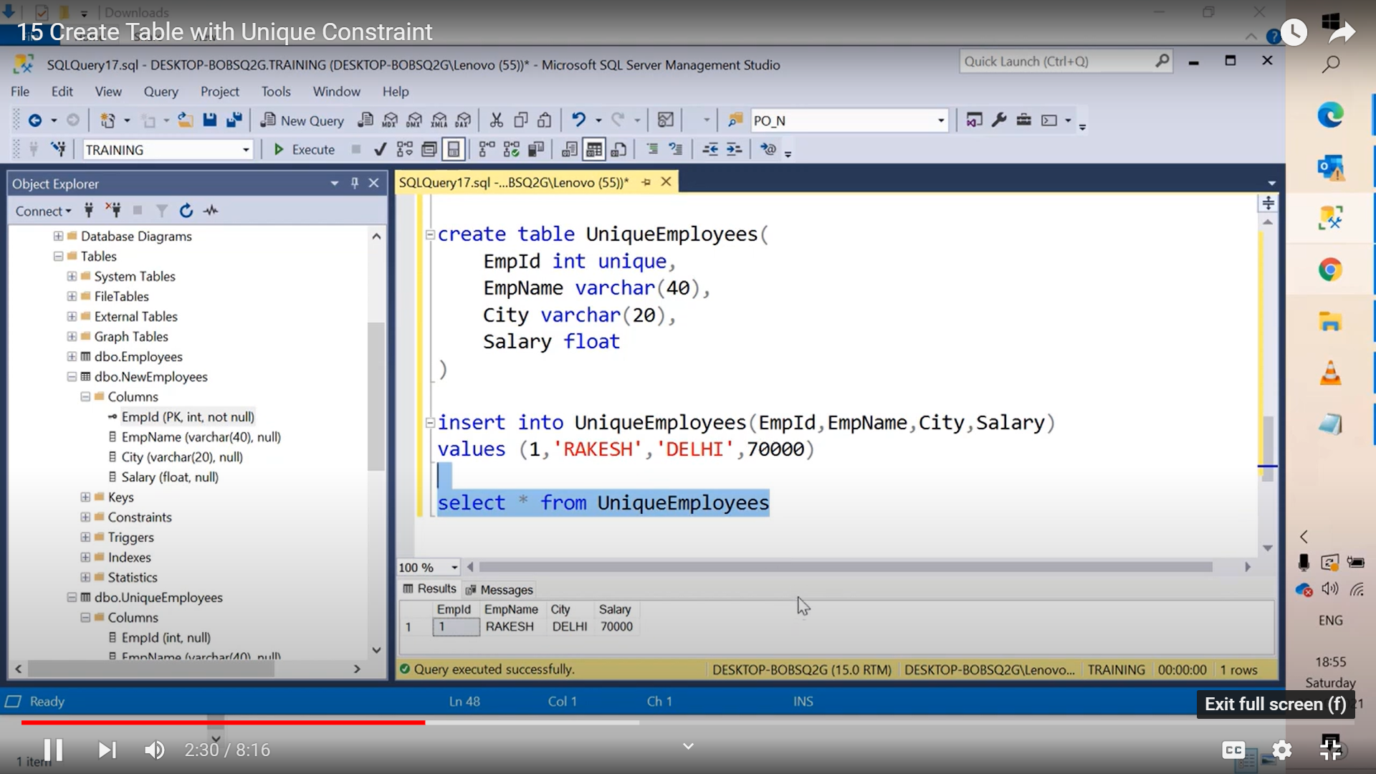
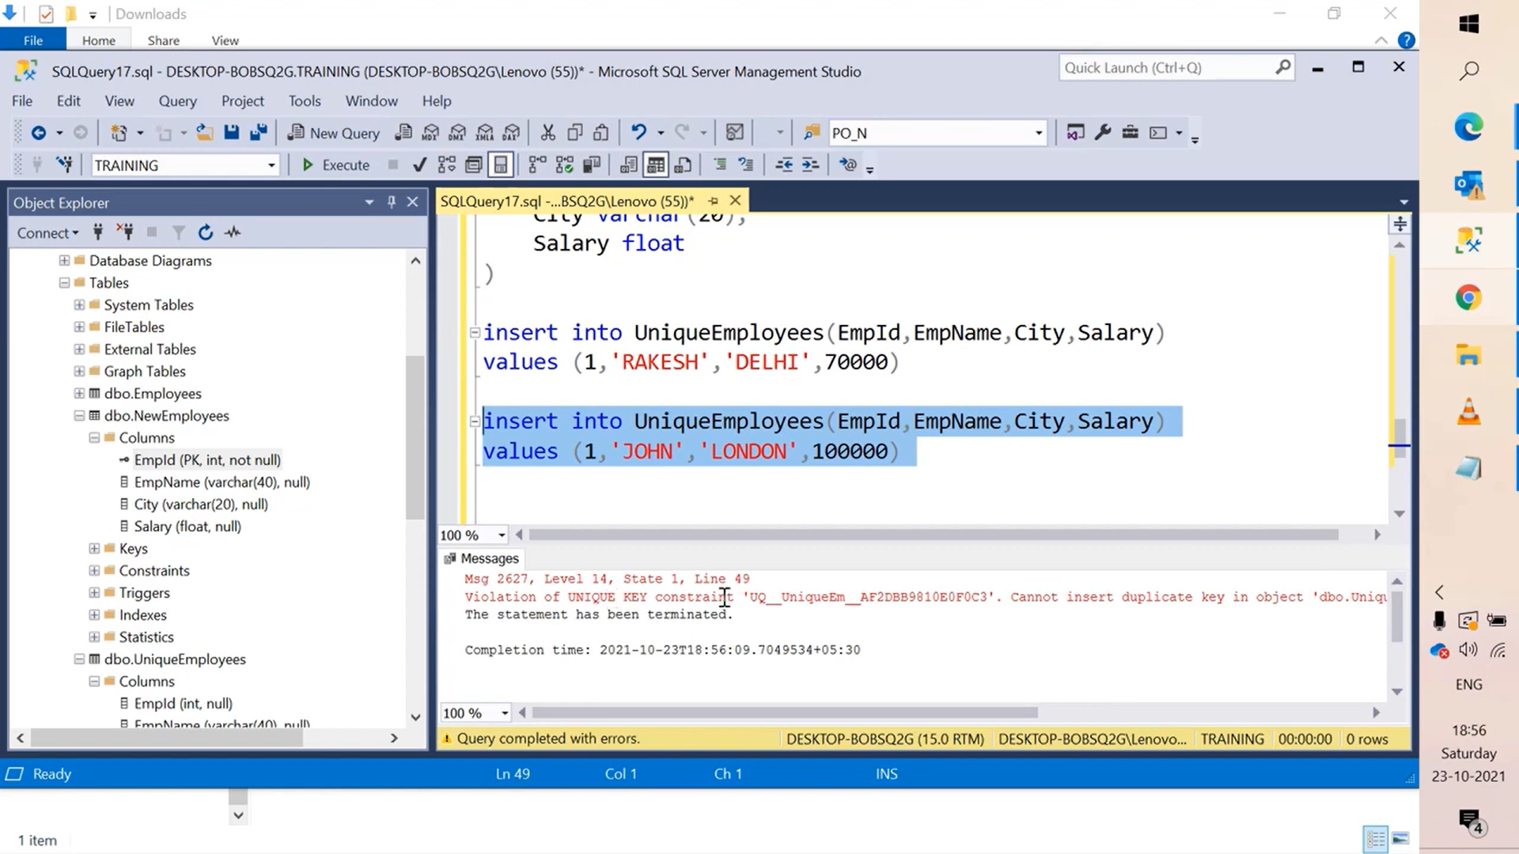
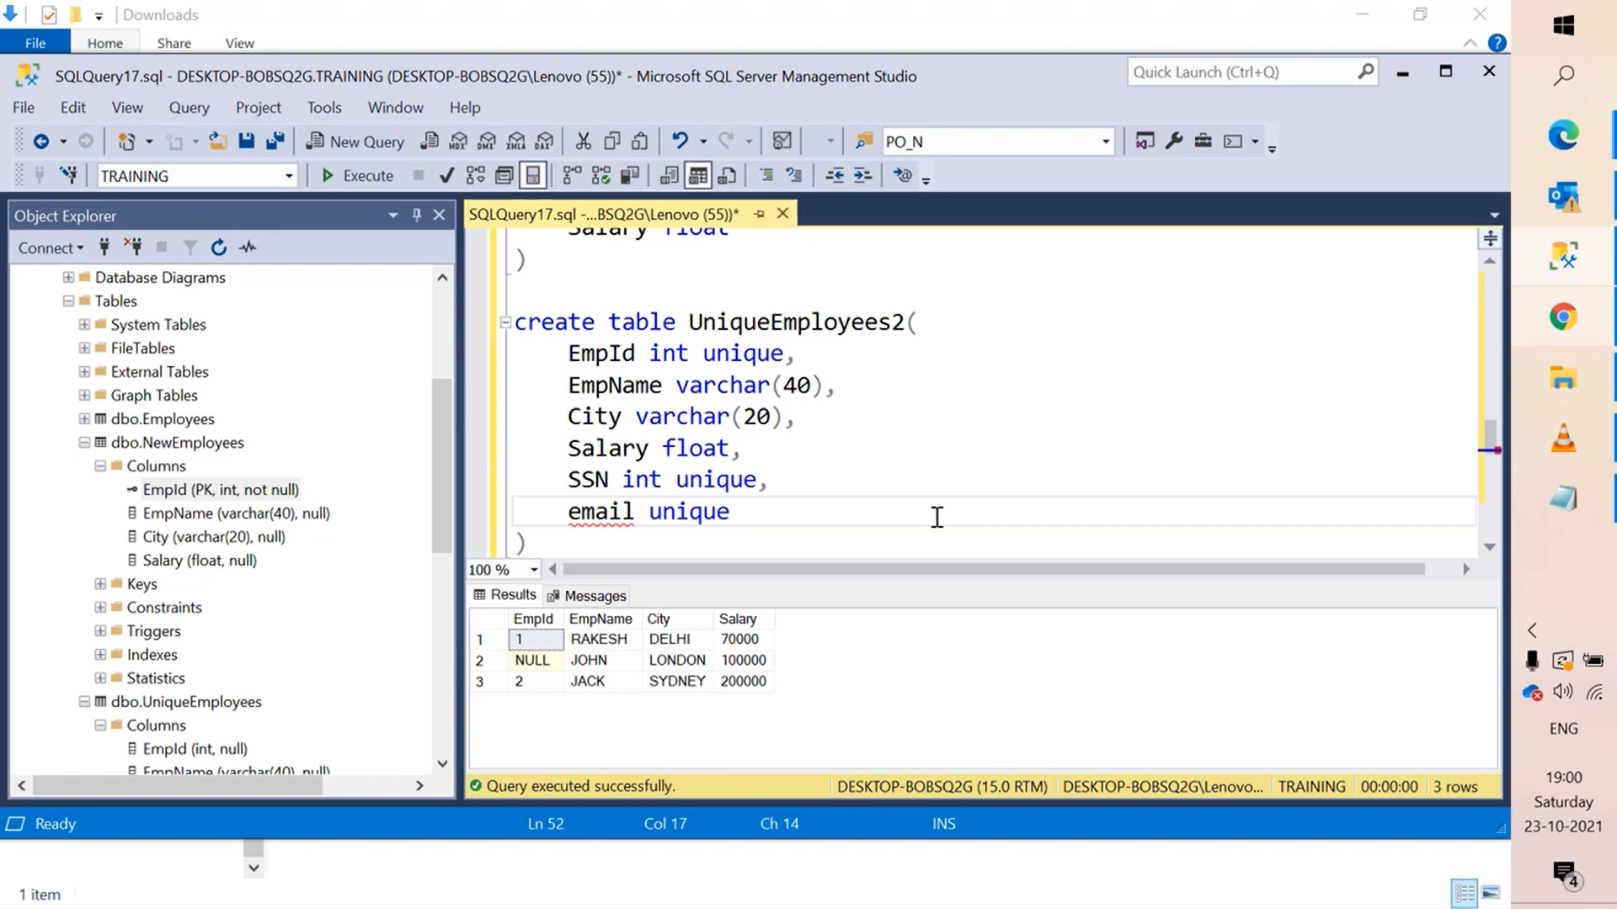
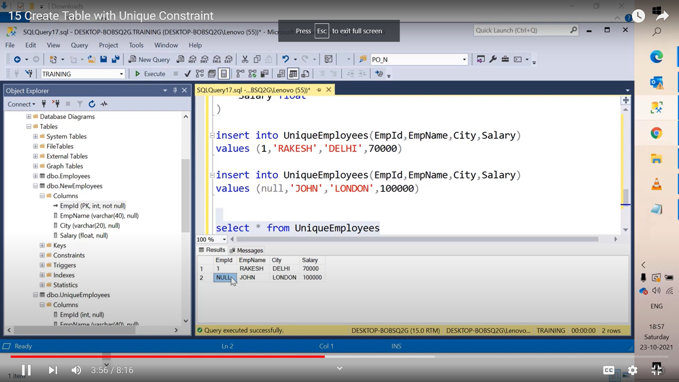
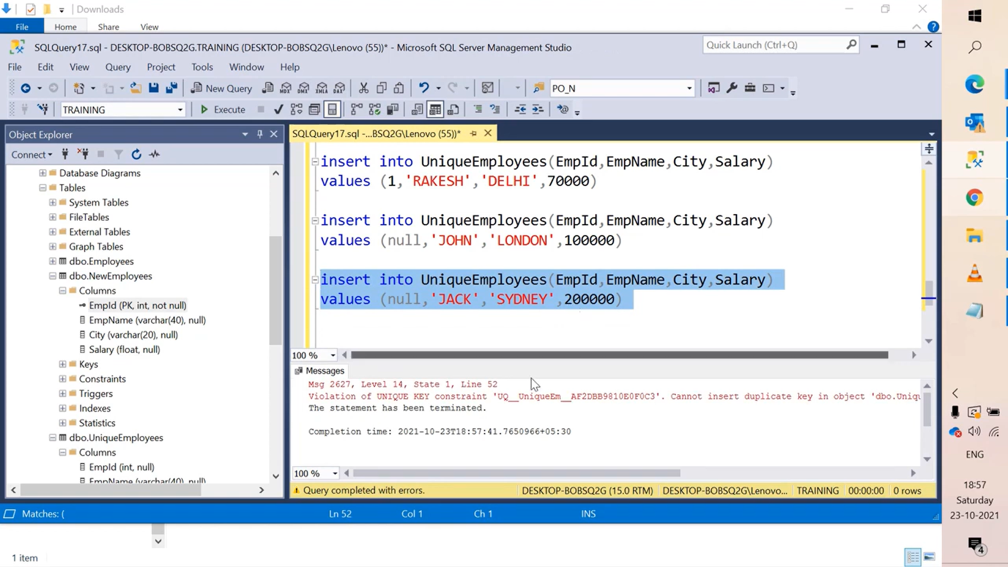
UNIQUE can be on multiple columns
1) Don’t allow duplicate data
unique
4) Unique allows to define multiple columns
3) Don’t allow duplicate NULL values
2) Allow NULL values

Slide 6
Primary key & Unique Constraint

Slide 7

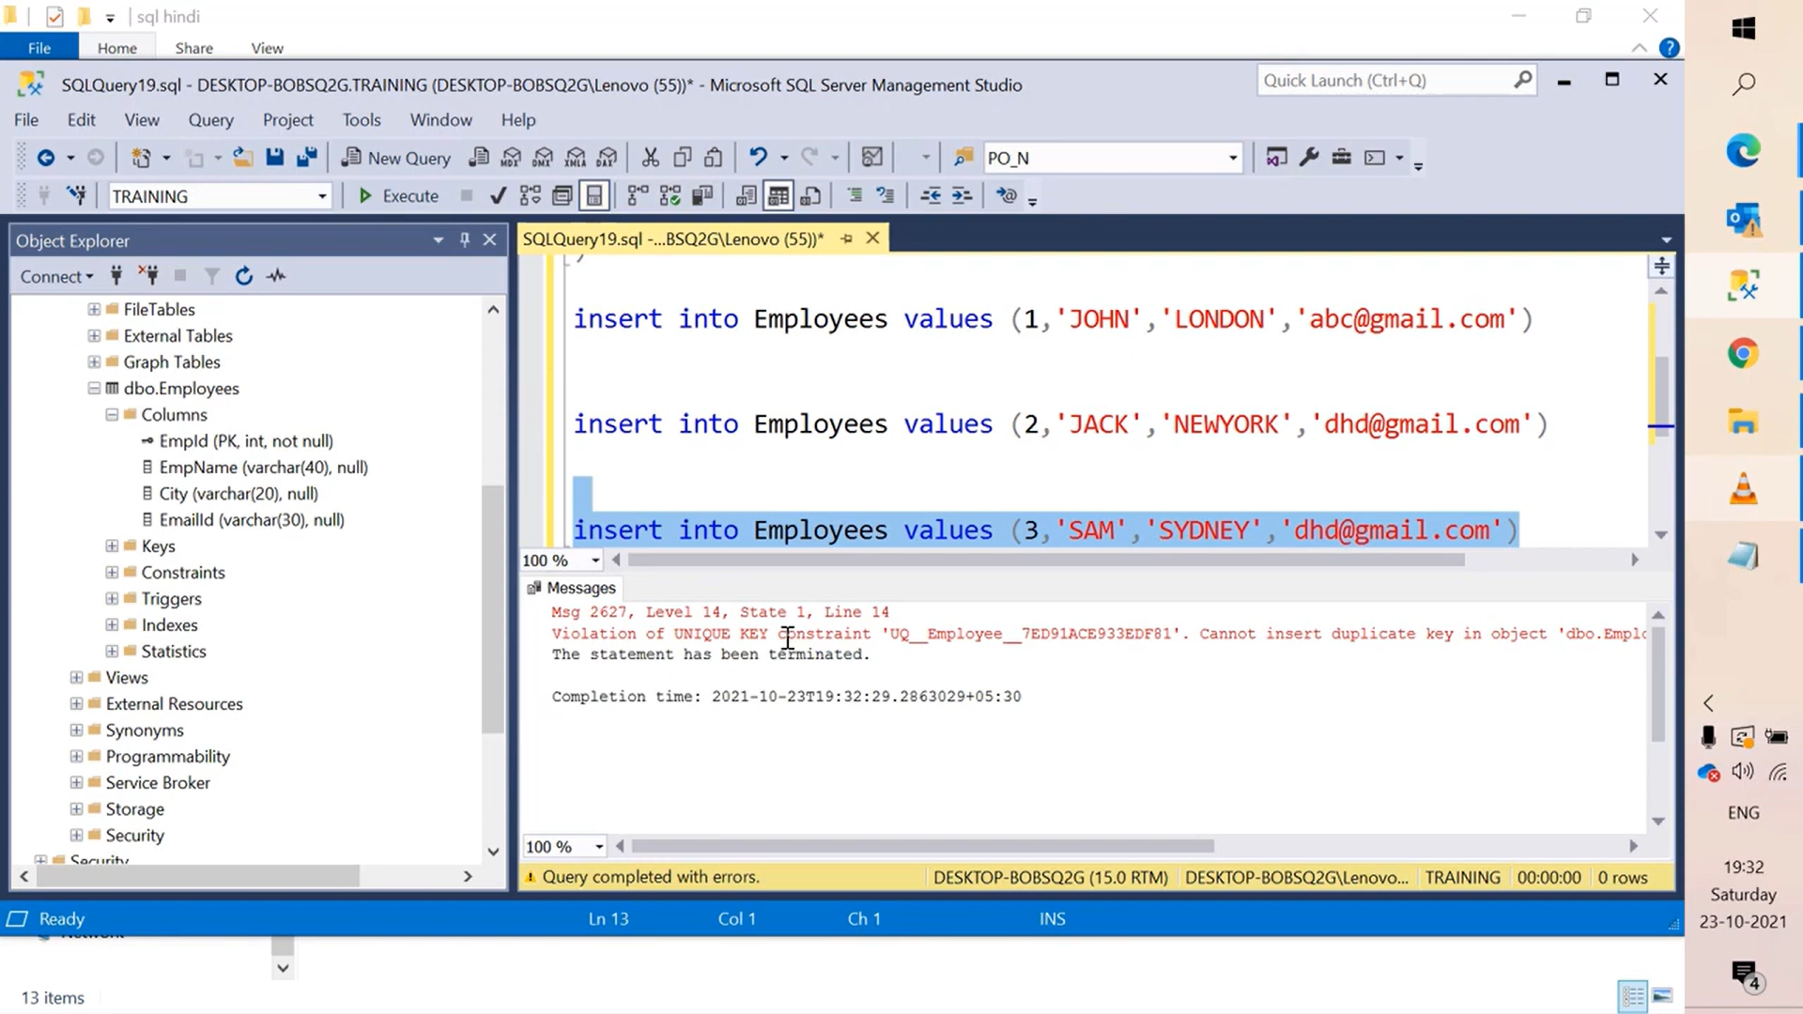


Slide 8
Composite primary key

Slide 9
